Slide 1


FAKE NEW DETECTION
GROUP : 14

Slide 2
INTRODUCTION
Fake news is a widespread problem in the digital age, especially on social media platforms like Twitter.
It has significant societal impacts, influencing public opinion and spreading misinformation.
Detecting fake news is challenging due to its resemblance to credible news formats.
Machine learning offers advanced techniques to analyze patterns in text, content, and user behavior.
Key goals include preventing misinformation, improving trust, and supporting fact-checking efforts.
Fake news detection contributes to a healthier and more reliable digital information environment.

Slide 3
LITERATURE REVIEW
Machine learning models like logistic regression, SVM, and deep learning techniques such as CNNs and RNNs are extensively used for fake news detection.
Text data is converted into numerical representations using techniques like TF-IDF and Bag of Words, facilitating effective feature extraction.
Bias in datasets is addressed through methods like lexical and sentiment analysis to improve model fairness.
Ensemble methods, including Random Forest and XGBoost, have shown superior performance by combining the strengths of multiple classifiers.
Continuous research focuses on enhancing feature extraction and adapting models to combat evolving fake news patterns.

Slide 4
METHODOLOGY
The project involves collecting and preprocessing a dataset of fake and real news articles, ensuring the data is clean, normalized, and ready for analysis.
Text data is then transformed into numerical features using techniques like TF-IDF or Bag of Words, allowing the models to process and analyze the content.
Various machine learning models, including SVM, Random Forest, and deep learning methods, are selected and trained on the prepared dataset to detect fake news.
The performance of the models is evaluated using key metrics such as accuracy, precision, recall, and F1-score to measure their effectiveness in identifying fake news.
The results of different models are compared to determine the most suitable approach, considering factors like model performance, speed, and scalability.

Slide 5
DATA USED
The dataset consists of two labeled sets: one for fake news, containing 23,481 articles, and the other for true news, with 21,417 articles. These articles cover a wide range of topics and sources to ensure variety and relevance.
The datasets are obtained from publicly available sources, including online news outlets, fact-checking websites, and social media platforms, to ensure a comprehensive representation of news content.
Both datasets are curated to include diverse writing styles and topics, making them suitable for training a robust fake news detection model.
The balanced size of the fake and true news datasets helps ensure fair model training, reducing the risk of class imbalance in classification tasks.

Slide 6
DATA PREPROCESSING
The data is first cleaned to remove irrelevant elements such as special characters, unnecessary punctuation, and stop words that do not contribute meaningful information to the analysis.
Text normalization techniques are applied to standardize the content, including converting all text to lowercase to ensure consistency across different articles.
The text is then tokenized, breaking it into individual words or phrases, which facilitates feature extraction and allows for better understanding of the content.
Additional preprocessing steps, such as stemming or lemmatization, may be performed to reduce words to their base form, further improving the accuracy of model training.

Slide 7
Feature Extraction
Textual features are extracted using Natural Language Processing (NLP) techniques to convert raw text into usable data for machine learning models.
Count Vectorization is used to transform the text into a matrix of token counts, representing the frequency of each word in the document.
TF-IDF (Term Frequency-Inverse Document Frequency) adjusts these term frequencies by weighing terms based on their importance relative to the entire dataset, giving more significance to distinctive and relevant terms.
These techniques ensure that the most informative features are captured and used for model training, improving the accuracy of the fake news detection system.

Slide 8
Model Selection
Various machine learning algorithms are applied to classify news articles as fake or true, with Logistic Regression, Decision Trees, and Random Forests as key models.
Logistic Regression is chosen for its simplicity and effectiveness in modeling the probability of an article being fake or true.
Decision Trees are selected for their ability to capture non-linear relationships in the data by splitting features at different levels.
Random Forest, an ensemble method, is used to aggregate predictions from multiple decision trees to improve accuracy and reduce overfitting.

Slide 9
Model Training
The dataset is split into training (80%) and testing (20%) sets to ensure proper model evaluation.
Each model is trained using the training set, and hyperparameters are fine-tuned to optimize performance and reduce errors.
Model training focuses on improving the accuracy of the classification task while minimizing false positives and false negatives.
Cross-validation is applied to ensure that models generalize well and avoid overfitting to specific subsets of the data.

Slide 10
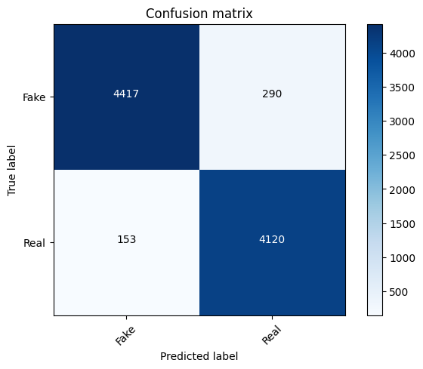
LOGISTIC REGRESSION
It is a effective machine learning
algorithm used for binary
classification , modeling the
probability that an input
belongs to a particular class , such
As fake and true news.

Slide 11

DECISION TREE
It is a machine learning model
that splits data into branches based
on feature values , creating a
tree – like structure to classify
data by capturing non – linear
Relationships.

Slide 12

Random Forest Classifier
It is an ensemble learning method
that combines multiple decision
trees to improve classification
accuracy and reduce overfitting by
aggregating the predictions of
each tree.

Slide 13

Support Vector Machine (SVM)
It is a supervised machine learning
algorithm that classifies data by
finding the optimal hyperplane
that maximizes the margin between
different classes.

Slide 14
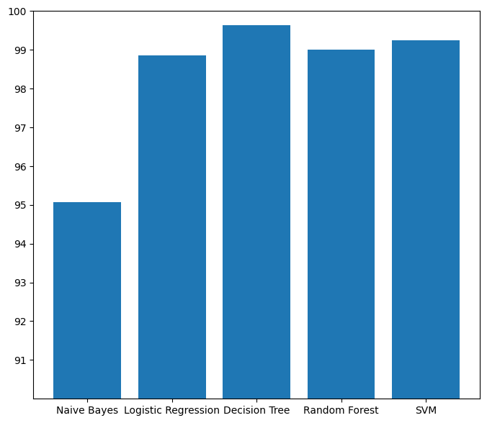
Comparitive Analysis

Slide 15
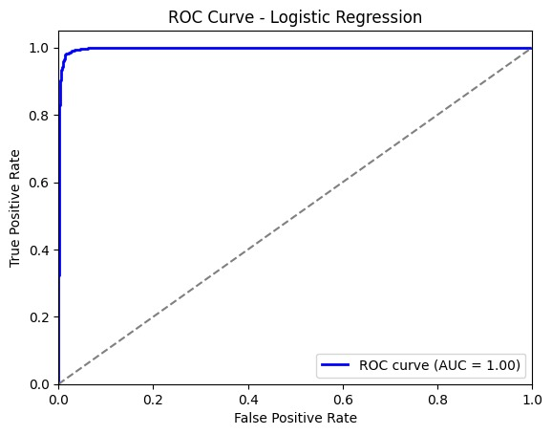
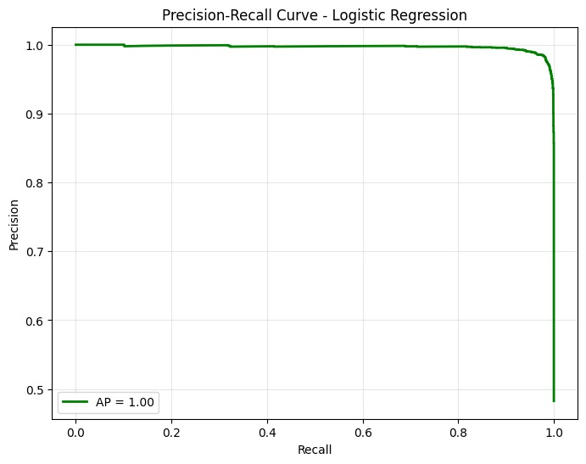
The image shows an ROC (Receiver Operating Characteristic) Curve for a logistic regression model. The curve indicates perfect model performance, with a true positive rate (TPR) of 1.0 across nearly all false positive rates (FPR). The area under the curve (AUC) is exactly 1.00, suggesting ideal classification. The diagonal gray dashed line represents a random classifier (AUC = 0.5) for comparison.
The image shows a Precision-Recall Curve for a logistic regression model. It indicates near-perfect performance, with precision remaining close to 1.0 across almost all recall levels. The Average Precision (AP) score is exactly 1.00, implying ideal classification with no trade-offs. The graph suggests a highly accurate model, though such results are unusual in real-world scenarios.

Slide 16
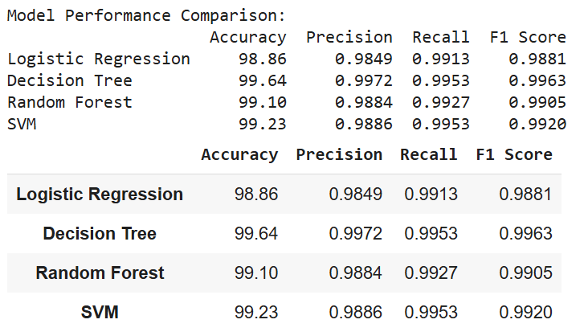
RESULTS

Slide 17
Future Work and Improvements
Future work could explore the use of advanced deep learning techniques, such as CNNs and RNNs, to better capture complex patterns and contextual relationships in text data, enhancing the accuracy of fake news detection.
Expanding the dataset to include a wider variety of news sources, languages, and multimodal data (e.g., images and videos) could improve the model’s ability to generalize across different contexts and platforms.
Employing methods like LIME (Local Interpretable Model-Agnostic Explanations) could enhance the interpretability of complex models, making the system’s predictions more transparent and fostering trust in real-world applications.

Slide 18
CONCLUSION
The project successfully developed a machine learning-based fake news detection system using NLP for feature extraction and various classification models.
A comparative analysis of models like logistic regression, decision trees, and Random Forest demonstrated that ensemble methods and decision trees performed better in handling complex patterns and achieving higher accuracy.
The results indicate that combining traditional machine learning models with advanced techniques, such as deep learning and social feature integration, could create more effective fake news detection systems.

Slide 19
REFERENCES
Ruchansky, N., Seo, S., & Liu, Y. (2017). "Csi: A framework for fake news detection." Proceedings of the 2017 IEEE International Conference on Data Mining (ICDM), 2017, 1213-1218. https://doi.org/10.1109/ICDM.2017.121
Yang, Z., Zhang, Y., & Salakhutdinov, R. (2019). "Fake news detection on social media: A data mining perspective." ACM Computing Surveys, 51(4), 1-34. https://doi.org/10.1145/3285029
Liu, Y., Wu, L., & Sattar, H. (2020). "A hybrid model for fake news detection using deep learning and social network features." Expert Systems with Applications, 159, 113687. https://doi.org/10.1016/j.eswa.2020.113687

Slide 20

Thank You!
GROUP : 14

